Slide 1

WOMEN AND CHILDREN COMPLAINT CENTRE (W3C)
Go-to-Market / Sustainability Proposal

Slide 2
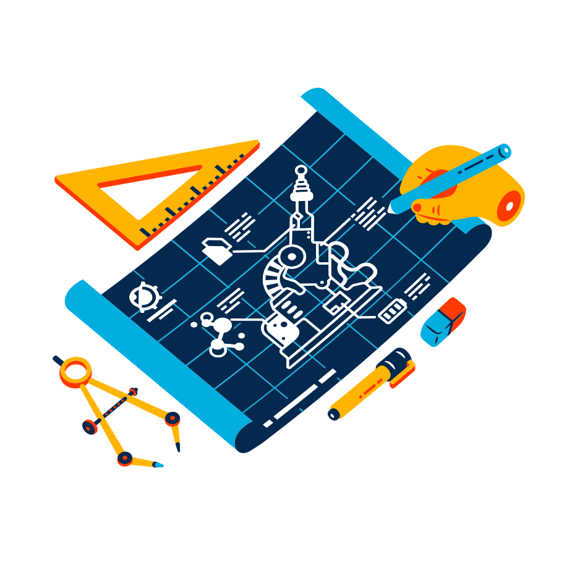
Intro of your capstone team
The capstone project C22-PS071 team consists of six people, four are active members and the other two are inactive members. This team has three learning paths that have different tasks, namely Machine Learning, Cloud Computing, and Mobile Development. Each learning path consists of two people. For Machine Learning, the members are Nissa Syifa Yuni Sagita from Ahmad Dahlan University and Rosydatul Muawanah from Billfath University. For Mobile Development, the members are Mohammad Akhdaan Juliandra from Muhammadiyah University, Prof. Dr. Hamka and Irfanka Ichtisan Shoeh Abdillah from Duta Bangsa University, Surakarta. Two members of Cloud Computing are inactive members, namely Muhammad Iqbal Tri Atmojo and Faisal Parsakh Nursyamsyi from Muhammadiyah University Prof Dr Hamka.
Our team chose the theme Women Empowerment, Child Protection, and Accessibility as the final project from Bankid Academy 2022 which was named the Women and Children Complaint Center (W3C). This application is expected to reduce the rate of increase in violence against women and children in Indonesia.

Slide 3
Backgrounder Facts
98 %
of the surveys we conducted agreed to make this application to solve the problems raised.

Slide 4
Intro of your capstone project
Why your capstone project is built in the first place?
With this capstone project, you can implement the knowledge gained during the training at Bangkit Academy 2022. This knowledge can be implemented to create a work to be implemented in the problems that are being discussed. One of the implementations is making an application in the form of a question and answer forum to reduce the number of violence against women and children in Indonesia. By using several libraries and also tools in the process, this application is designed to make it easier for people who are survivors of violence to consult and also tell stories comfortably without including their identity.
What are the advantages of your capstone project?
The appearance of the application is comfortable and easy to use.
User identity can be disguised.
There are not many features that can interfere when using the application.

Slide 5
Backgrounder
What are you trying to achieve/solve?
Is there anything been done before?
There are still many cases of violence against women and children in Indonesia. The complaint service made by the government for the community has not had a significant effect so that many of the community have difficulty when faced with this problem. Therefore, our team tries to make an application that is easily accessible for anyone to tell stories or file complaints on related issues.
The government has facilitated the community by setting up a call center for Sahabat Perempuan dan Anak (SAPA) 129. This service is in the form of direct complaints via telephone. Judging from the use of these services, there are several problems that have not been optimally implemented to the community. The creation of this application is expected to help the community to more easily tell stories or make a complaint regarding related problems.

Slide 6
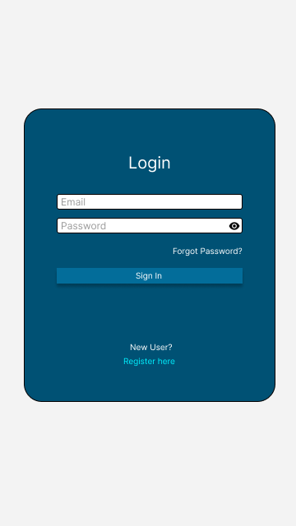
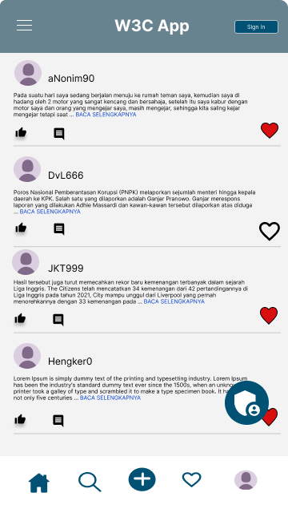
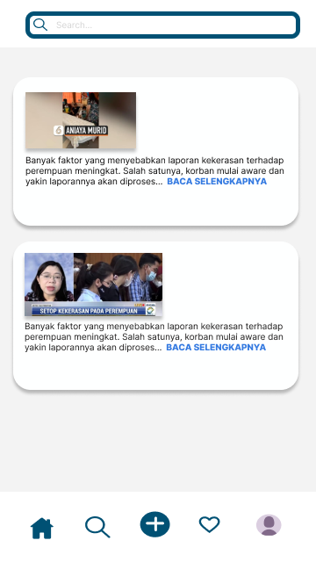
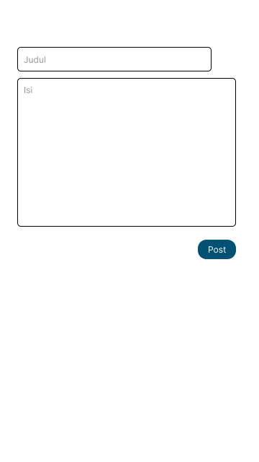

Slide 7

Target Market or Personas
The target market for users of this application are survivors of violence from all walks of life, both women, children, and men from toddlers to elderly women. There is no age or profession limit in using the application, all people can access it.

Slide 8
Why your target market needs your solution?
Supported by case information data that has been inputted by the government, cases of violence like this still occur in Indonesia and continue to increase every year. The government has services to overcome these problems, but when viewed from its use it is still not optimal to support the community in submitting complaints. Therefore, with the application that we made, it is hoped that it will be able to assist the government in handling this case as a first step in preventing the increase in cases.
This project can collaborate with several government institutions that are in accordance with the chosen theme, such as services for handling violence against women and children which have been stated in the legislation in local government.

Slide 9
Comparison to similar services/apps
90 % better
(Based On Testing)

Slide 10
Your Roadmap
Commercial Value
Making applications to support the reduction of violence against women and children is very rare, so it will have a great opportunity for commercial value in making applications like this.
Business Opportunities
People who want to submit complaints regarding related problems can go through this application, with collaboration with the government or related institutions they can support developments in making this application.
Technology Advantages
With current technological advances, the upgrade of violence complaint services must be more accessible and also used by the wider community. Using easy libraries and tools can have a significant impact on this problem.
Tackling bigger problems in the future
This is expected to help the community in sharing experiences and complaints regarding related issues and is also expected to reduce the number of violence against women and children in Indonesia.
Benefits for long-term
This is expected to help the community in sharing experiences and complaints regarding related issues and is also expected to reduce the number of violence against women and children in Indonesia.

Slide 11
Your Possible Pilot/Trial on the next 6 months
Actual local (Indonesia) implementation of the project you’ve done - for the next six months
Make it in public, by release at Google Play Store and added some features to make it more usable for users.
Timeline
Menambah relasi dengan lembaga yang terkait seperti pihak berwajib, psikiater atau psikolog.
Add some features : Added a feature to consult a psychologist or the police.
Budgeting
$425 / Rp 6.185.025
Roles
Fix a dataset and accuracy by adding a training data.

Slide 12
Project Milestones for 2022
(to end of year)
Forming a team, determining the theme and also making project proposals.
Preparation to create new features in the form of UI design for W3C application development.
Develop a feature that is lacking and try to use it for the public.
April
July
September
May-June
August
Create predictive models and create UI/UX designs and also deploy models.
Preparation of cooperation with government institutions and mental health institutions.

Slide 13
Budgeting - 1 - USD 5k / IDR 70m
Category | Proportions (max) | Budget (max) in USD
Team Salary (4 person) | 30% | $1.500 / Rp 21.951.750
Research / Operational | 70% | $4.000 / Rp 58.476.000
Prototyping | 26% | $1.250 / Rp 18.268.750
learning/capacity building, survey/FGD/data collections | 24% | $1.000 / Rp 14.615.000
transportation expenses | 5% | $700 / Rp 10.230.500
legalities, patent/copyright registration, product certificateion | 15% | $550 / Rp 8.038.250
*1 USD = Rp 14.643

Slide 14

Budgeting - 2 - USD 10k / IDR 140m
Category | Proportions | Budget (max) in USD
All aspects covered in Budgeting - 1 | 50% | $5.000 / Rp 73.172.500
Additional Budget for Team Salary | 15% | $1.500 / Rp 21.951.750
Additional Budget for Research/Ops | 20% | $1.750/ Rp 25.618.250
Marketing and Sales | 20% | $1.850 / Rp 27.082.150
Market research and competitive analysis | 10% | $1.000 / Rp 14.639.500
Future Development / R&D | 20% | $2.000 / Rp 29.279.000
Tax | 7% | $750 / Rp 10.979.625

Slide 15
Sustainability
Sources of Income
Efficiency Priority
Sales (penjualan) App: $1.750 / Rp 25.618.250
Ads : $45 / Rp 658.701 per Month
Subscription (langganan): $1 (Rp 14.268) / Month
Rounds of Funding (pembiayaan): $425 / Rp 6.221.065 per Month
Running with bare-minimum operations
Reducing overhead and unnecessary costs
Choose appropriate services and third-party vendors

Slide 16
Based on the 5k/10k USD Budgeting, expectations are
5K Funding
10K Funding
Expected Runway: 12 months / years
Expected Headcount: 8 people
Assets: - patent/copyright
- data
- nventory
Expected Runway: 20 months / 1.6 years
Expected Headcount: 14 people
Market Positioning:
Assets: - knowledge / trained persons
- data

